Slide 1
2023 NCATS Summer Coding Camp
Andy Patt, Tim Sheils, Kyle Spencer, Mark Williams, Ewy Mathé, Arjun Yadaw, Lihui Hu

Slide 2

Overview of 2023 NCATS Coding Camp
Goal: To provide assisted learning in coding concepts in a virtual environment. Tailored to both beginner or seasoned computational experts and no previous experience is required.
Outcomes:
Introduction to GitHub and team coding best practices
Advance knowledge and skills in a particular language or application of software/methods of participant’s choice.
Code that you could reuse in the future
Community building
The more effort you put in, the more you’ll get out of it!

Slide 3
Course Organization
Camp will run from 6/9 – 7/28. Group meetings are Fridays at 11 am.
There will be ~12 ‘campers’. Ideally, we’ll have small groups of 1-2 people per TA.
All code, course descriptions, useful links, etc. will be organized in our GitHub site
Testing out the new NCATS notebook hub for collaborative coding/easy setup!
Communication will largely happen via our Slack channel
Each camper will briefly present on their project at the end of the camp.

Slide 4
Expectations
TAs
~3 hours available per week (1 hour as a group)
Help break up project into steps
Provide technical guidance/feedback on coding issues, revising timeline, etc.
Provide links to useful resources and share amongst the wider group
Help administer the GitHub Site
Be responsive on Slack outside of formal meeting times to help along
Campers
~ 8 hours per week on project
Come up with a project
Communicate effectively with TA and larger group to get feedback
Ask questions, don’t stay blocked
Creating a presentation at the end of camp
Document your progress: take snapshots, include versions of software you’re using, explain input
Reach out to me at andrew.patt@nih.gov!
Notes:
Add a “Resources doc” on GitHub

Slide 5
Quick points on expectations/etiquette/documents
Working in a virtual environment takes proactivity!
Reach out to your mentors, peers, or Ewy as you need
Do not wait for others to reach out to you if you have a question
Turn on your video when in a meeting
Use your Slack!
Documentation/information:
A summary of all docs can be found here: https://docs.google.com/document/d/1rkLYqeHoaQOKKI2xL_QBl9D3-ak1gPwUR_wfl0W9M24/edit
Check your email frequently. Expect frequent emails from Dr. Yewon Cheon (from NIH OITE)
You will have to juggle schedules between activities from IFX, NCATS OTE, NIH OITE, and your mentors. Prioritize V-SOAR activities over NCATS activities.

Slide 6


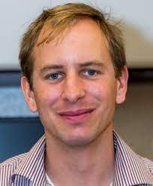

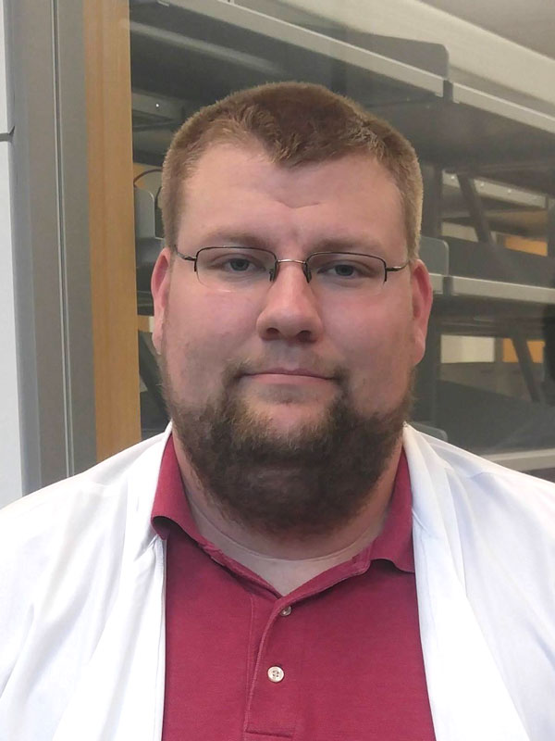
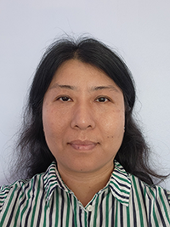
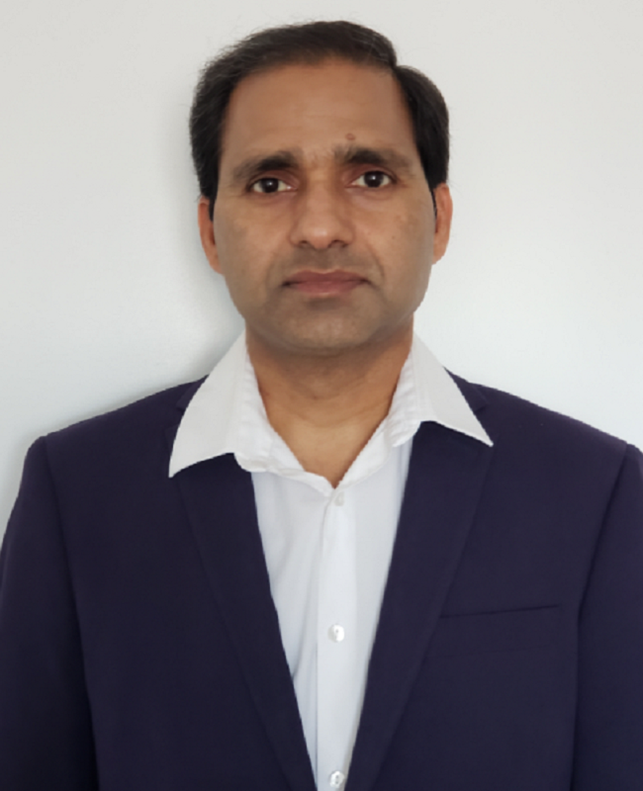
Meet your TAs
Ewy Mathé
R/RStudio
Andy Patt
R/RStudio
Tim Sheils
Javascript, HTML
Mark Williams
Python/Java/Perl
Kyle Spencer
R/RStudio
Lihui Hu
Java/Eclipse
Arjun Yadaw
Python/SQL
Notes:
Consortia meta-analyses pool data centrally for analysis, or used a

Slide 7
Meet your campers
VSOAR:
Iris Pang
Hanna Barsouk
Danyal Raza
Sylvanie Johnson
SIP:
Gavrila C. Wicaksono
Godwin Aizenofe
NCATS Fellows/Staff:
Pranav Shah
Glenn Gomba
Abhi Asthana
Mayra Alvarez
Sourav Pal
Brittany Poeleart
Temidayo Adegbenro
Please take 5 minutes to fill this out if you haven’t already:
https://forms.gle/tyWYjuiUGPFfqD9dA
Notes:
Live polling:
Why did you sign up for this class? Do you have specific goal(s)/expectation(s) for the class?
What relevant math (e.g. statistics, linear algebra, formal logic, etc) or programming classes have you taken, if any?
What programming language do you prefer, if any, and how proficient are you?
Keep it up 50 words or less

Slide 8
First Homework
Get a Slack account and send Andy your Slack ID to be added to the class Slack channel
Go to nihncats.slack.com and sign in with NIH credentials
If you want Slack installed on your desktop, you’ll need to submit an IT ticket (https://myitsm.nih.gov/sp)
Get a GitHub account
Get an account (can use personal or NIH email)
Send ID to your TA or Andy so they can add you to the repo with “write” access
Select a TA and a project. Here are some points to consider when selecting a project:
You only have 8 weeks, and it’ll fly by!
Be realistic in what you can achieve and start small (it’s easy enough to scale up)
Reach out to TAs individually to help with your selection
This is a great opportunity to work on something you’ve always wanted to but never took the time to do
If you can line it up with your current work, great!
Create a subfolder under your TA’s folder with a short description of your project and a draft timeline of the weeks to come
Be ready to talk about your project next Friday in 2-3 min (one powerpoint slide, if any)
Notes:
Potentiallly be lenient for 5

Slide 9
Looking ahead
Camp Prep: Read over project ideas, click here
Week1: Introduction, finalize project selection and timeline, get set up on GitHub/Slack/Notebook Hub, first meeting with TA
Weeks 2-6: Keep working on tasks, revise timeline as appropriate
Week 7/8: Final project presentation prep and presentations
Week 4 → large group check-in
Notes:
Week 1: 06/17
Week 2: 06/24
Week 3: 07/01
Week 4: 07/08
Week 5: 07/15
Week 6: 07/22
Week 7: 07/29
Week 8: 08/05

Slide 10
Weekly Meetings
Formal time, set aside, to meet as a larger group.
This is a chance to share progress, and get feedback from the wider group.
If there is a particular skill or resources that multiple campers are looking to expand upon, we can use this time to also lecture on that skill (TAs needs at least 2 days heads up and this will depend on ask)
Remember to ask questions and share what you’re doing! Chances are, someone is asking themselves the same thing so we can all learn from each other!

Slide 11
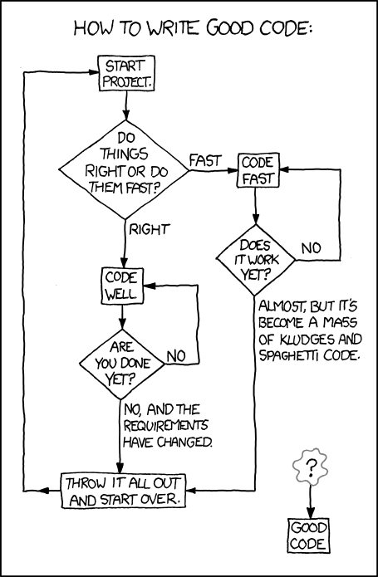
Final Thoughts
Work with your TA to set weekly goals and deadlines so that you can progress throughout the camp
Setting up your coding environment and getting code to work takes time, be patient
Dedicate appropriate time to this camp, this camp is largely self-driven
Questions? There’s always Slack, your TAs, or contact Andy directly
XKCD

Slide 12
What is Git
Free, open-source version control system (like CVS, Subversion, etc.)
Automatically tracks changes between versions
No need for different names (e.g. File_v1, File_v2, …, File_Final, File_FinalFinal)
Very useful for team coding (if you’re ambitious, you can also use this to write papers)
Requires you to give a brief description of what changes you made
Bonus 1: you can readily go back to previous versions if you don’t like the changes made
Bonus 2: a good way to create a community!
Notes:
Consortia meta-analyses pool data centrally for analysis, or used a

Slide 13
Software Based on Git
Numerous software rely on Git: GitHub, GitLab, Bitbucket, etc.
NCATS has 398 GitHub repositories
84 are public (anyone can access)
266 are private (designated members only can access)
48 are internal (anyone within NCATS can access)
Quick Tutorial Overview
https://www.youtube.com/watch?v=iv8rSLsi1xo
Let’s take a look at our GitHub repository for the camp:
https://github.com/ncats/2023SpringCodingCamp
* The repo is public
* All the class code will be uploaded in this repository
Notes:
Consortia meta-analyses pool data centrally for analysis, or used a

Slide 14
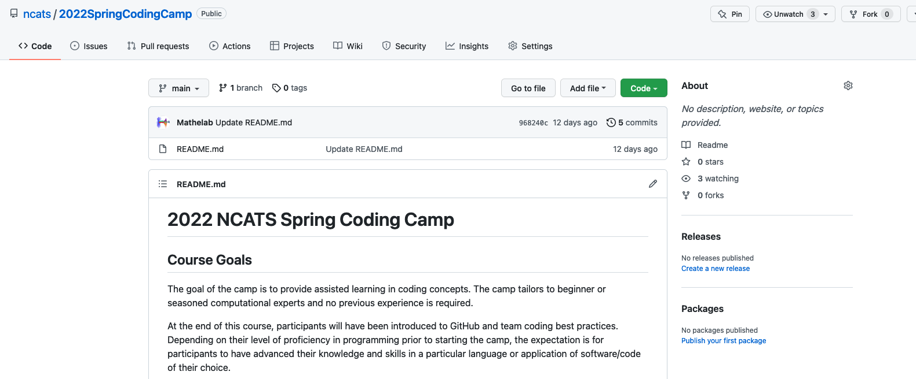
Our camp GitHub repo
https://github.com/ncats/2023SpringCodingCamp
* The repo is public
* All the class code will be uploaded in this repository
Notes:
Consortia meta-analyses pool data centrally for analysis, or used a

Slide 15
























Notebooks Hub – Tool for Interactive Data Science
Prototype
Share
Publish
Reproducible
Secure
Ready To Go
Notes:
Notebooks Hub is a tool for Data Science explorative data analysis, collaboration and dissemination combining JupyterLab, environment modules and dashboarding tools such as Streamlit, Voila and Shiny
Prototype - code using powerful and familiar IDEs
JupyterLab
RStudio
VSCode
Share - create interactive dashboards from your code and share them: no setup is required by the recepient
R Shiny – interactive dashboards from R code
Voila – interactive dashboards from Jupyter Notebooks
Strasmlit – Python dashboards for Machine Learning usecases
Publish - write papers in LaTeX editor
Easy access to your data to generate figures
Collaborative editing
Secure
NCATS Notebooks Hub is deployed behind NIH VPN as a part of STRIDES account
NIH login with PIV card
Data is stored securely for each user
Powerful hardware
Multiple hardware options to select from
Practically unlimited storage for datasets
NVIDIA GPUs are available and configured with the latest drivers, CUDA
Automatically scales up and down to adjust available resources
Zero install – runs in browser with zero installation and minimal hardware requirements
Ready to go – batteries are included
Easy to get started with multiple languages preinstalled which are being used in NCATS: Python, R, Java, Julia, Octave, C++
Most popular machine learning libraries are pre-installed, zero config required
Environments are fixed for all users which allows reproducibility

Slide 16












Notebooks Hub features
Same Environment
Runs in a browser
GPUs
Technical Support
Quick Launch
Real Time Collaboration
Code Examples
Dashboards
Notes:
Providing unified infrastructure in the Cloud with exactly the same environment for all students and instructors
If there is an error, instructors/Polus Team would likely observe the same error and will be able to fix it
Don’t need to worry about differences in students' OS, hardware, everything runs in a browser
NVIDIA drivers and CUDA are preinstalled if GPU hardware is used. Server hardware configuration (CPU/GPU/RAM) for advanced projects, i.e. Machine Learning, Deep Learning
We are providing Technical support for Notebooks Hub
Target different user skill levels
Single click JupyterLab, VSCode and RStudio servers on the main page for beginners. 0 configuration for users, customizable by admin
Real-Time Collaboration in JupyterLab (student-instructor, student-student, etc)
Examples that users can try
Dashboards - Create interactive webapps in Jupyter, Python and R for showcasing the results

Slide 17
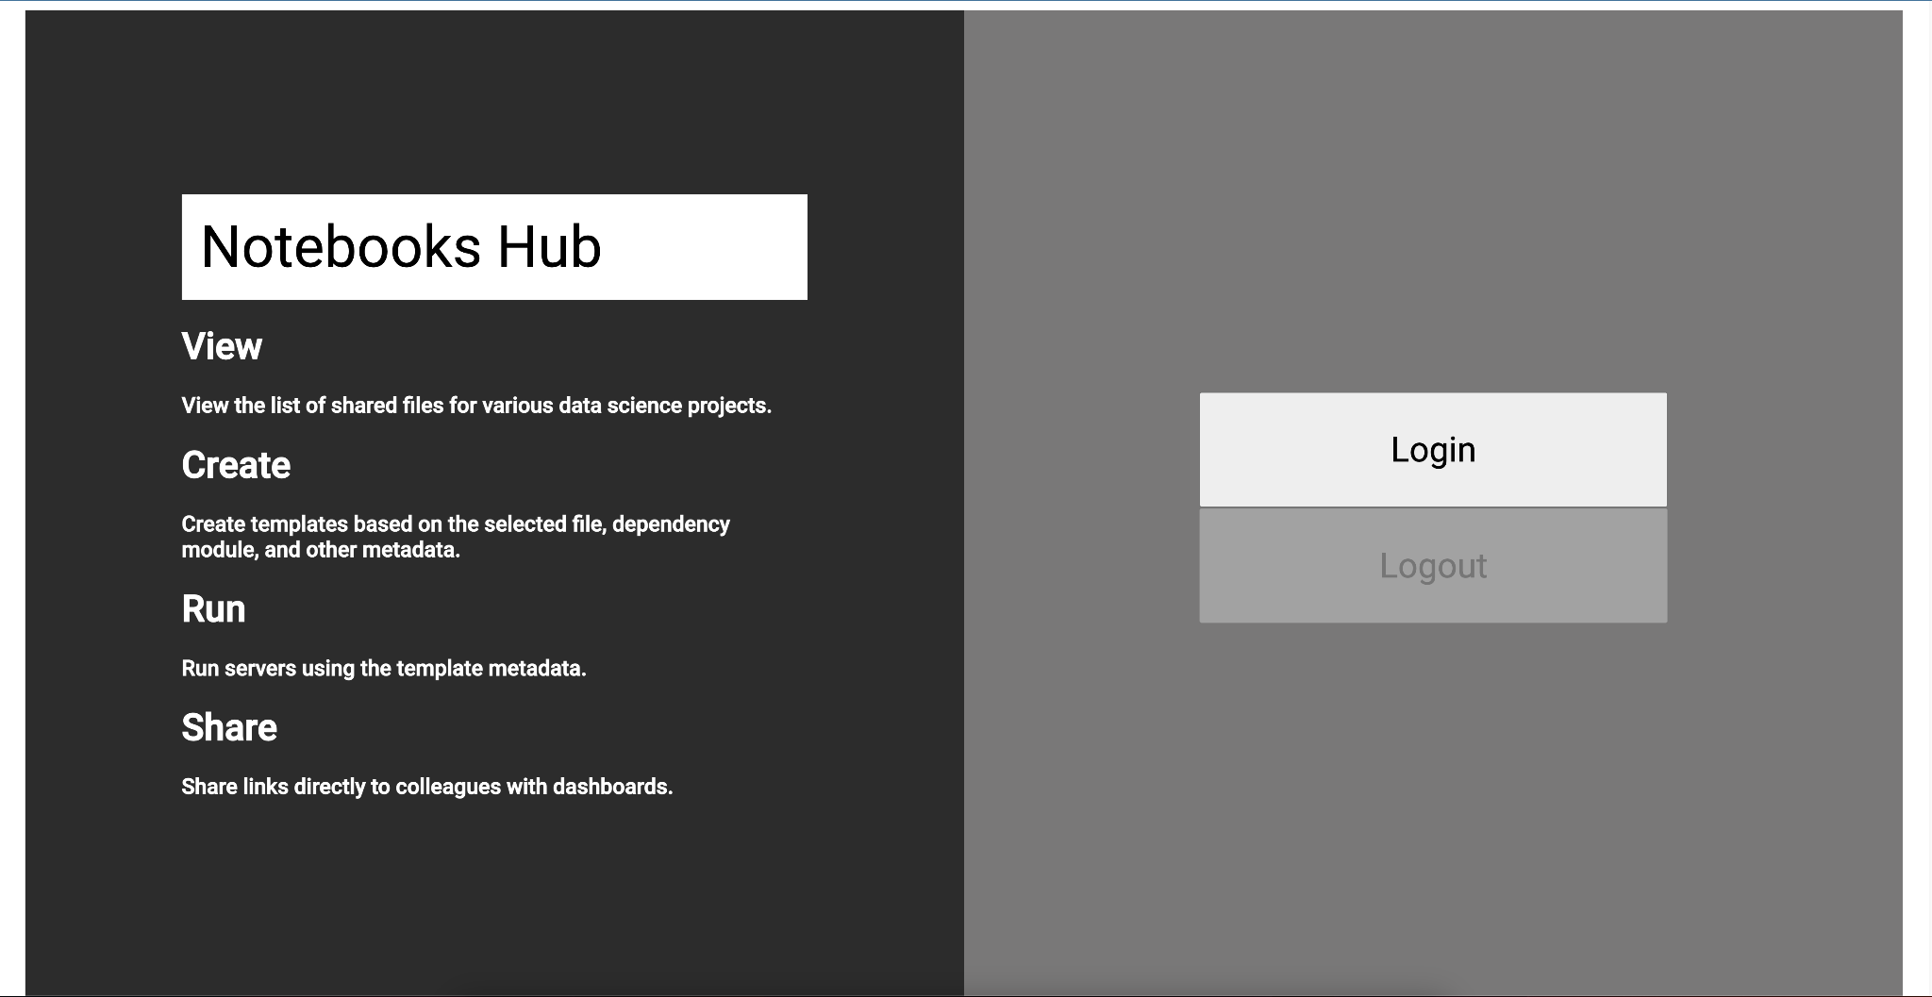
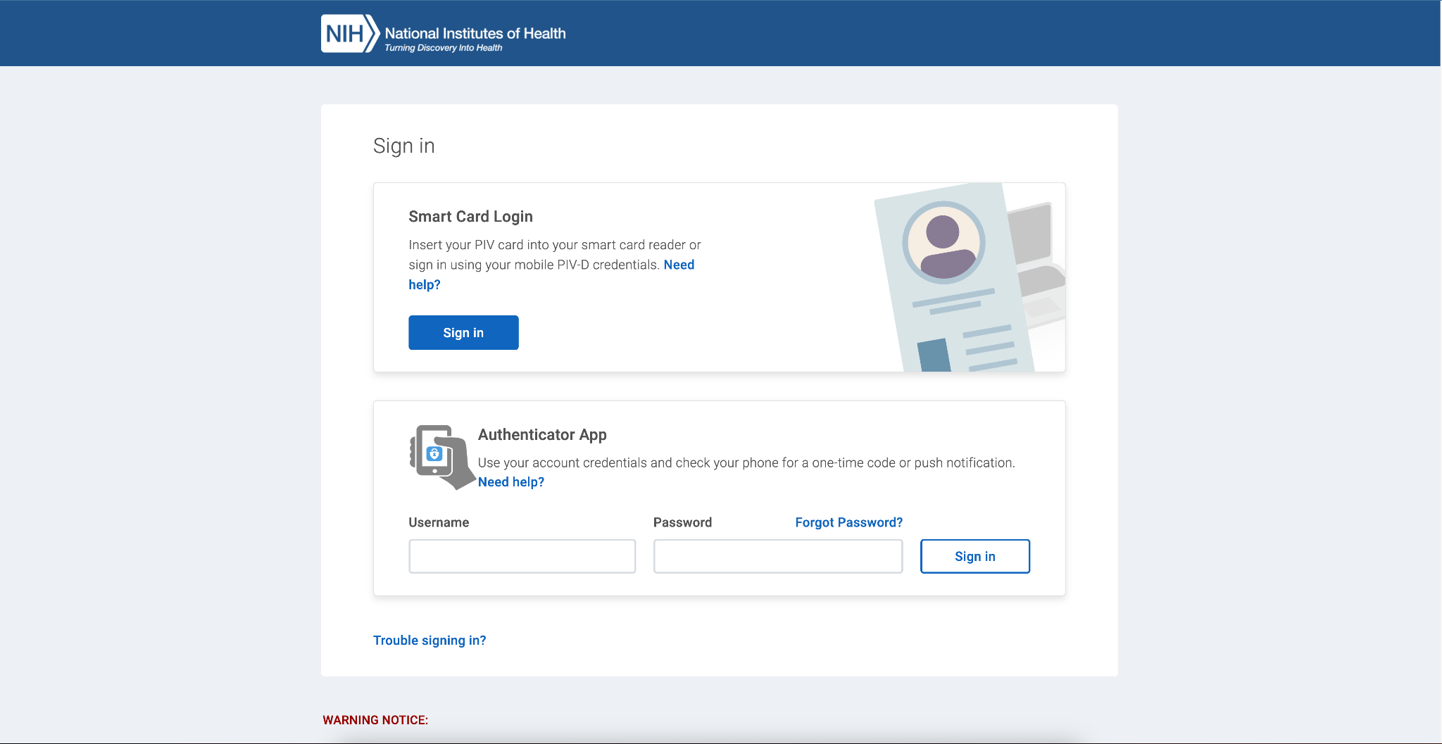
Logging In
Go to https://hub.scb-ncats.io/ in your browser
Click Login, and use your NIH credentials to login
You should be redirected to the Home screen of Notebooks Hub
Notes:
Notebooks Hub is a tool for Data Science explorative data analysis, collaboration and dissemination combining JupyterLab, environment modules and dashboarding tools such as Streamlit, Voila and Shiny
Prototype - code using powerful and familiar IDEs
JupyterLab
RStudio
VSCode
Share - create interactive dashboards from your code and share them: no setup is required by the recepient
R Shiny – interactive dashboards from R code
Voila – interactive dashboards from Jupyter Notebooks
Strasmlit – Python dashboards for Machine Learning usecases
Publish - write papers in LaTeX editor
Easy access to your data to generate figures
Collaborative editing
Secure
NCATS Notebooks Hub is deployed behind NIH VPN as a part of STRIDES account
NIH login with PIV card
Data is stored securely for each user
Powerful hardware
Multiple hardware options to select from
Practically unlimited storage for datasets
NVIDIA GPUs are available and configured with the latest drivers, CUDA
Automatically scales up and down to adjust available resources
Zero install – runs in browser with zero installation and minimal hardware requirements
Ready to go – batteries are included
Easy to get started with multiple languages preinstalled which are being used in NCATS: Python, R, Java, Julia, Octave, C++
Most popular machine learning libraries are pre-installed, zero config required
Environments are fixed for all users which allows reproducibility

Slide 18
Languages, their uses, and resources
Languages
R/Rstudio/Rshiny (scripting language): commonly used in Biostatistics/Bioinformatics, powerful statistics and visualizations
Python (scripting language): commonly used in machine learning and data science
Java (compiled language): commonly used to develop applications (e.g. workflows, software that can run on multiple platforms)
JavaScript (scripting language): used to develop web applications (advanced functions for drop-down menus, contact forms, etc.)
Perl (scripting language): powerful parsing language with advanced regular expression capabilities
* All have a strong community where you can find snippets of code, get your questions answered, etc.
Resources?
Biostars, StackOverflow, YouTube, and Google
Check out this link for more
Notes:
Consortia meta-analyses pool data centrally for analysis, or used a

Slide 19
How to communicate when you’re stuck
Never think a question is too stupid to ask! Chances are, someone is asking themselves the same thing.
Include example line of code and error/warning you receive (e.g. send a snapshot photo or copy/paste code)
Describe your input clearly as this helps troubleshoot
Sometimes, it’s unclear what the output means, show your example line of code and all of the output
Always provide the version of the software you’re using
→ In a nutshell, provide enough information so your TA can reproduce the error!

